Slide 1
BU Course Builder
Group 1 (BUAN!) Natasya Liew: Team Leader Natthaphon Foithong: Design and Implementation Lead Ananya Singh: Security Lead Battal Cevik: QA Lead Poom Chantarapornrat: Requirement Lead Yu Jun Liu: Configuration Lead

Slide 2
Introduction to BUAN
A chatbot-driven web application to assist students with course selection.
Uses GPT-4o via Langchain API for personalized recommendations.
Frontend: React/Redux, Backend: Spring Boot, Database: PostgreSQL.
AI-Driven: Python for AI integration, Course recommendations based on student profiles.

Slide 3
Design Goals
Seamless chatbot interaction via real-time communication.
Modular architecture for easy maintenance and scalability.
Performance optimization with client-side and server-side caching.
Secure authentication using Okta and JWT tokens.

Slide 4
Software Architecture
Frontend: React/Vite with WebSocket integration
Backend: Spring Boot for authentication and chat handling
AI Layer: Python LangChain for intelligent chatbot responses
Database: PostgreSQL for chat history, course info, and user data
CI/CD: Docker, GitHub Actions, AWS EC2 for deployment

Slide 5
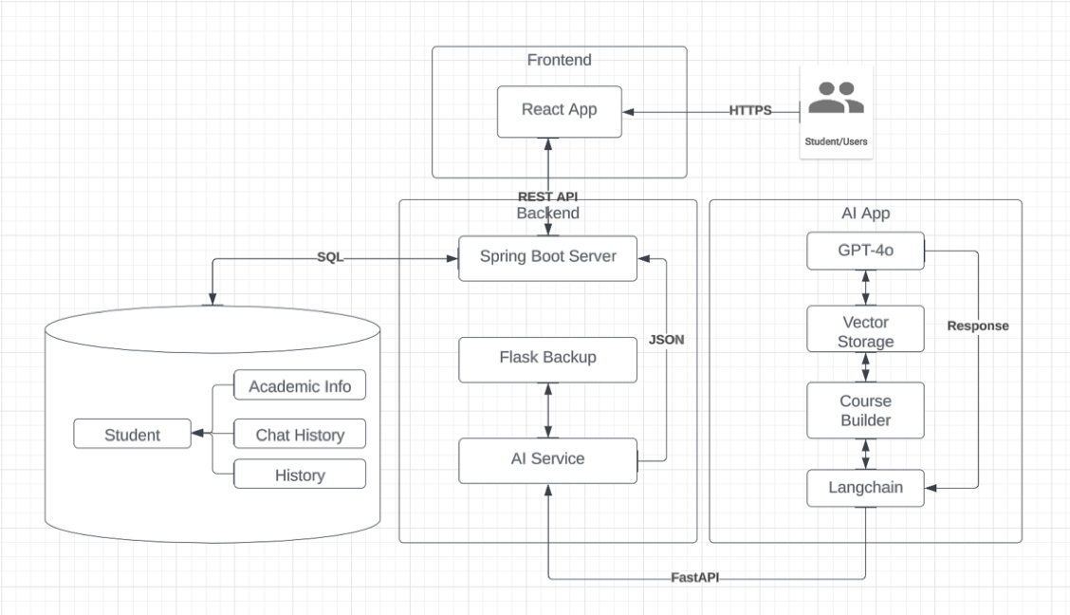
Architecture Diagram

Slide 6
Frameworks and Libraries
Frontend: React.js, Vite, Axios, Redux, Material UI
Backend: Java (Spring Boot), Maven, Okta SDK, JWT Tokens
AI Layer: Langchain, FastAPI, Pinecone, Pandas
Automation Testing: Selenium, TestNG, Maven, Rest Assured API

Slide 7
Testing and Deployment
Unit Testing: React, Spring Boot, Python AI modules tested individually.
Integration Testing: Ensures seamless communication between the frontend, backend, and AI services.
Regression Testing: Full application tested to ensure all features work as intended.
Automated Testing: Selenium for UI testing, PyTest for backend.
Deployment: AWS EC2 Instance for production deployment

Slide 8
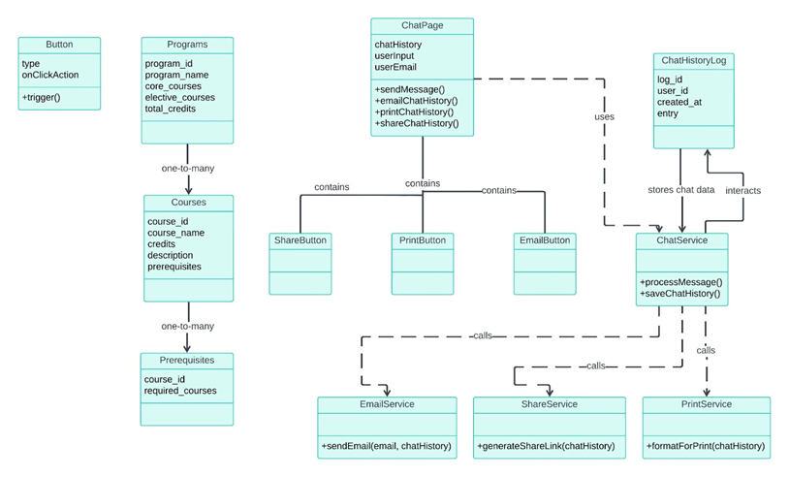
Class Diagram

Slide 9
UI Design Overview
Layout: Two-column, two-row structure
Left Column: Side panel for actions (New chat, end chat, email, share, print, logout)
Right Column: Chat interface for conversation
Key UI Components
Chat Interface:
Chat Window: Main area for conversation
Message Bubbles: Distinct bubbles for user (right) and bot (left) messages
Input Field: Text box, send button, optional Grammarly check
Action Buttons:
End Chat: Logout and close session
Email Chat History: Send transcript via email
Share Chat: Generate shareable link
Print History: Prepare chat for printing

Slide 10
UI Design Colors and Typography
Color Palette:
#E54500 (Orange-red)
#675DFF (Blue)
#FFD0BC (Light orange)
#FFFFFF (White)
Typography: Outfit

Slide 11
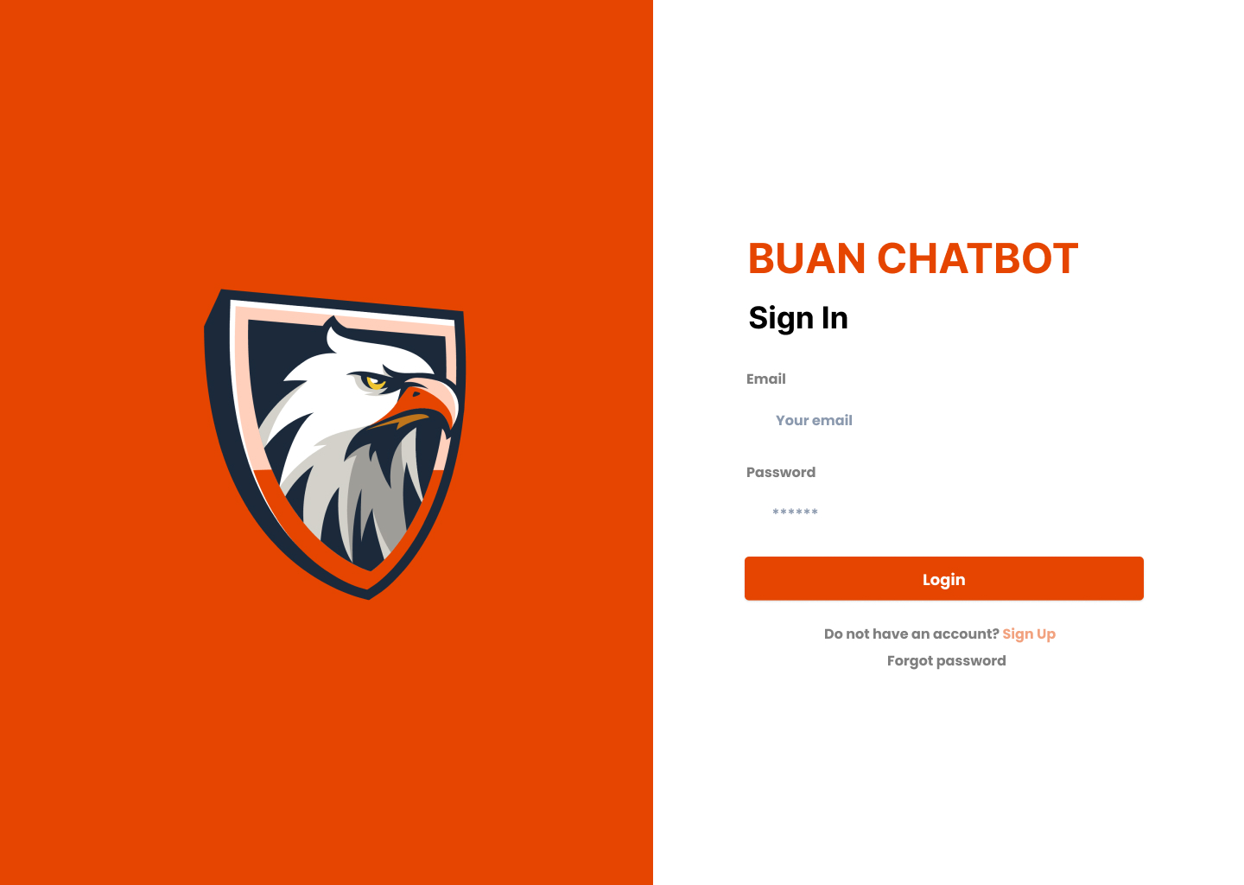
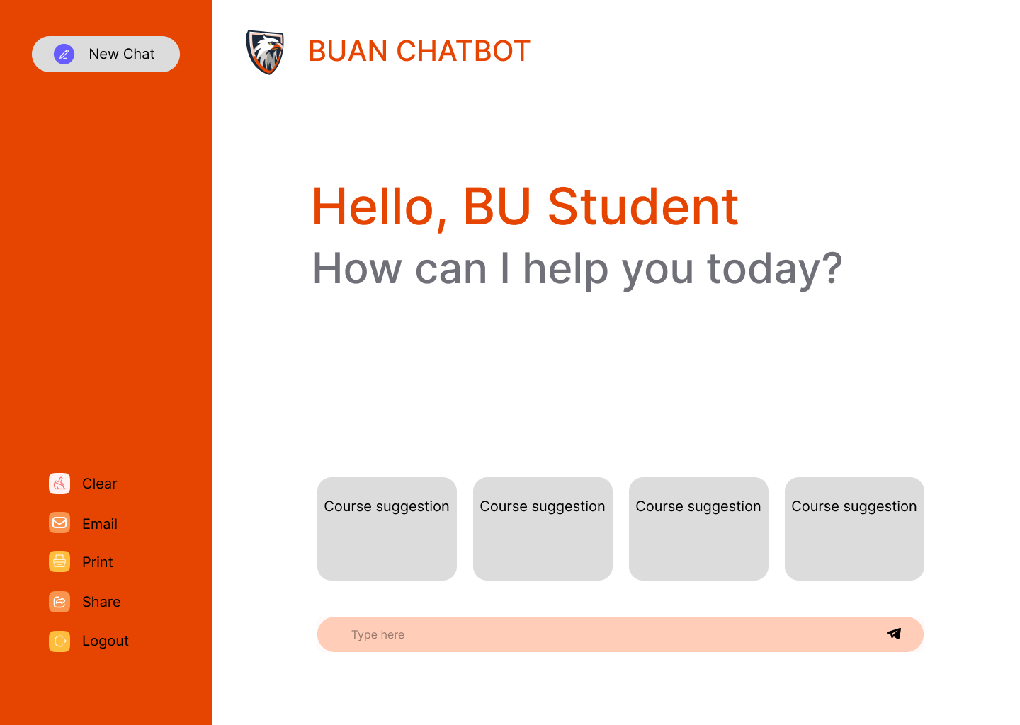
Mockup Design

Slide 12
Database Design
PostgreSQL Collections:
Programs: program_id, program_name, core_courses, elective_courses, total_credits
Courses: course_id, course_name, credits, description, prerequisites
Prerequisites: course_id, required_courses
ChatHistoryLog: log_id, user_id, created_at, entry
Future Integration
Potential integration with BU’s Student Management System for enhanced personalization.

Slide 13
Security Design
User Authentication: Okta integration for secure login.
Sensitive Data Handling: Minimization and encryption of PII, chat logs retention.
Email Security: Encrypted email contents and attachments.
Sharing Security: Time-limited unique URLs for shared chats.
Session Management: Automatic logout after inactivity.

Slide 14
Business Logic and Key Algorithms
Program and Course Information Retrieval: Query programs and courses for detailed information.
Course Selection Assistance: Recommend courses based on user’s academic interests and history.
Personalized Chat History: Cache and retrieve past interactions to maintain context.
Complex Query Handling: Address multifaceted queries with custom logic.

Slide 15
Algorithm Overview: Course Builder
Input
Programs Data: Reads from CSV to create a dictionary of program attributes (core/elective courses, prerequisites).
Courses Data: Reads from CSV to generate a dictionary of course details.
Student Profile: Contains completed courses, declared interests, and desired courses to take.

Slide 16
Algorithm Overview: Course Builder (cont…)
Core Functions
CourseTree Class: Manages course recommendations via a tree structure.
add_branch: Adds course sequences to the tree while avoiding completed or skipped courses.
build_mssd_tree: Constructs a course tree based on student interests and completed courses.
recommend_courses: Traverses the tree to recommend courses for the next semester.

Slide 17
Algorithm Overview: Course Builder (cont…)
Algorithm Operation
Tree Construction: Builds a course tree dynamically based on the student's path of interest.
Recommendation Process: Identifies courses not yet taken and recommends them in the correct sequence.
Time Complexity
Tree Construction & Recommendation: Approximately O(n), where n is the total number of courses.

Slide 18
Algorithm Overview: Course Builder (cont…)
Outputs
Program and course data dictionaries.
Recommended course list based on the student’s profile.

Slide 19
Design Patterns
Factory Method Pattern
Purpose: Creates service instances based on user requests (e.g., Course Recommendations, Course Information).
Implementation: ChatServiceFactory dynamically generates appropriate service classes.
Observer Pattern
Purpose: Ensures real-time updates across chatbot components.
Implementation: ChatSession notifies observers (e.g., ChatWindow, ChatHistoryLogger) of changes.

Slide 20
Models & Tools
Chatbot Model
ChatGPT 4.0 via Langchain API: Powers course recommendations and information lookup.
Functionality:
Course Recommendations: Analyzes student data to suggest upcoming semester courses.
Course Information Lookup: Provides details about specific courses on request.

Slide 21
Models & Tools
User Interaction Flow
User logs in with email.
Inputs profile parameters (program, interests, courses taken).
Receives personalized course recommendations.
Can query further course details.
Chat history is cached for future reference.

Slide 22
Risk Management
Main risks identified: dropping out, lack of motivation, and inconsistent work output
Communication via Discord
Aware of integration challenges, lack of testing, and technology learning curves
Unforeseen changes or additions to the project scope can lead to delays, and loss of focus.
Integrating multiple technologies may result in compatibility issues, leading to delays or suboptimal performance.
Distributed teams and lack of clear communication channels may result in misaligned goals, duplicated work, or missed deadlines.

Slide 23
Team Github and UI Mockups
https://github.com/BUMETCS673/seprojects-cs673olf24team1
https://www.figma.com/design/gjNG1bADwnFxgDqclMwQVQ/Chat-AI-Bot---673ONE---final-mockup?node-id=0-1

